Slide 1

Smart Devices & Services Supporting Independence & Aging in Place
Sample Presentation for Senior Audiences
August 26, 2019
Collaborating Organization’s Name Here
Extending Knowledge – Changing Lives

Slide 2
What We’ll Present Today
Definition of Smart Technology,
Devices & Services
Benefits of Living in a Home with
Smart Devices & Services
  Safety & Security
  Comfort
  Convenience
  Control
  Cost Savings
Resources to Help You Investigate
Smart Device Use in Your Home
  Consumer Guide to Aging in Place
  Smart Self Reliance Clearinghouse
  www.smartselfreliance.org
  Directory of Senior Specialist
  Device Installers in Illinois
Contacts for Additional Information

Slide 3

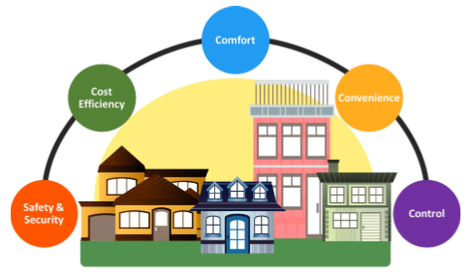
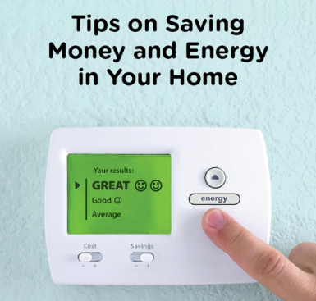
Smart Home Technology, Devices & Services
Smart Home Technology:
  Technology that uses devices connected to the Internet to automate,
  monitor & control home systems, appliances & other features.
Smart Home Devices:
  Devices designed to enhance safety, security, comfort & convenience
  of the home that can be controlled through applications on a smart
  phone, tablet, computer or voice-activated digital assistant.
Smart Home Services:
  Services made possible by the exchange of data between service provider
  & homeowner through a smart device. Example: Utility smart meter pricing programs that save customers money for using energy when demand is low.

Slide 4
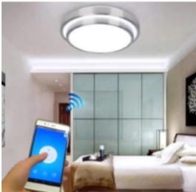
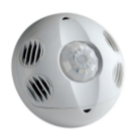
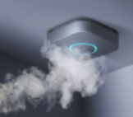
Benefits: Safety & Security
Relevant Concern:
  Accidental falls are the leading cause of injury-related death among adults over 65. Inadequate lighting & access to it are major contributors to fall-related deaths.
How Can Smart Devices Enhance Your Safety?
  Lighting can be controlled from any location with a smart phone or tablet or by voice with a digital assistant.
  With the aid of occupancy sensors, lighting automatically turns on when you’re in the room & off when you leave.
  Smart phones & tablets can also control (turn on/off)
  a smoke detector without having to touch the device, thereby eliminating the risk of falling from a ladder.
Home Lighting & Safety Devices
Smart Remote
Lighting Controls
Smart Occupancy
Lighting Controls
Smart Smoke & Carbon Monoxide Detectors

Slide 5
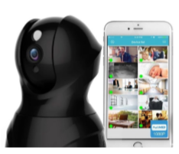
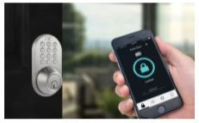
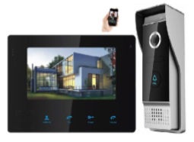
Benefits: Safety & Security
Home Security Devices
Relevant Concern:
  Personal security is one of the top concerns among
  adults aging in place & particularly for older adults
  living alone that are more susceptible to predators.
How Can Smart Devices Enhance Your Security?
  Cameras allow a resident to monitor & record the home’s interior &/or exterior on a phone or tablet from any location.
  Smart door locks allow a resident to operate door locks
  on a phone or by voice command with a digital assistant.
  Smart doorbell/monitor devices combine the function
  of the previous 2 devices & many also allow 2-way audio too.
Smart Cameras
& Monitors
Smart Door Locks
Smart Doorbells
& Cameras

Slide 6
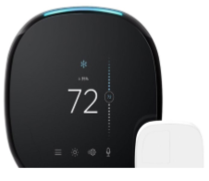
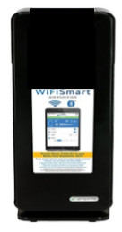
Benefits: Comfort
Relevant Concerns:
  As a person ages, the ability to maintain a satisfactory temperature is reduced while vulnerability to indoor air pollutants increase, especially for those with health issues.
How Can Smart Devices Enhance Your Comfort?
  Smart thermostats maintain safe heat, air-conditioning
  & humidity levels through use of climate sensors & can
  be controlled by a phone, tablet or by voice commands.
  Smart thermostats can also “learn” a resident’s preferred temperature settings & maintain them automatically.
  Smart air purifiers enable residents to monitor & control air quality from any location & remove odors & allergens.
Home Comfort Devices
Smart
Thermostats
Smart
Air Purifiers

Slide 7
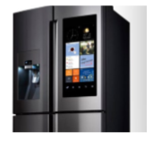
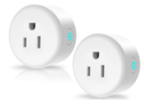
Benefits: Convenience
Relevant Concern:
  Vision & hearing impairments, physical mobility limitations,
  & memory loss that can accompany aging & make controlling
  home appliances less convenient & more challenging to use.
How Can Smart Devices Enhance Your Convenience?
  Smart refrigerators, washers, dryers, dishwashers, ovens
  & ranges can all be conveniently controlled by phone,
  tablet & in many cases, by voice with a digital assistant.
  Most of these remote control devices have settings that can accommodate impairments & limitations common to aging.
  Smart outlets can remotely control practically any connected device from any location & many can be programmed as well.
Home Convenience Devices
Smart
Appliances
Smart
Outlets

Slide 8
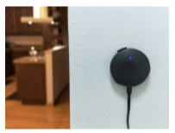
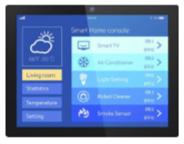
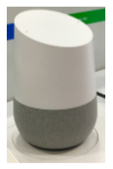
Benefits: Control
Home Control Devices
Relevant Concern:
  Controlling the operation & cost of home systems that keep you safe, secure, healthy, comfortable, & connected with family & friends can be a challenge for anyone.
How Can Smart Devices Enhance Your Control?
  Most smart devices can be connected to a single device
  known as a “Hub” & controlled on a phone or tablet.
  Smart displays enable: monitoring of home energy use & cost
  at any given time, the control of other connected devices,
  & viewing of personal photos shared between family & friends.
  A digital home assistant can: serve as a hub for smart home devices, make calls, send messages, play music, read the news & audio books, & control home entertainment centers.
Smart
Hubs
Smart In-Home
Displays
Smart
Digital Assistants

Slide 9
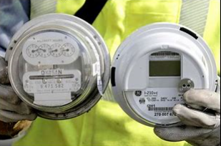


Benefits: Cost Savings
Relevant Concern:
  Annual increases in the cost of living, rising property taxes & costs associated with home maintenance, healthcare & prescription drugs challenge us all & particularly those on fixed incomes.
How Can Smart Devices & Services Enhance Your Cost Savings?
  New utility smart meters enable customers to see & control their energy use & costs & participate in preferred pricing & reward programs:
    Real-Time or Hourly Pricing
    Peak-Time Savings or Rewards
    Connected Devices or Home Area Network
  Participation in these utility programs can save customers an average of 15% on their electricity supply costs compared to a fixed-price rate.
Cost Saving
Devices & Services

Slide 10
Resources
FREE Guidance to help you explore the benefits of smart technology & to learn
what you need to know to select, purchase & have them installed in your home
Consumer Guide to Aging in Place: Smart Technology & Services
On-line information clearinghouse on smart devices that support independence
& aging in place
A training program for smart device installers & a directory to graduates
1
2
3

Slide 11
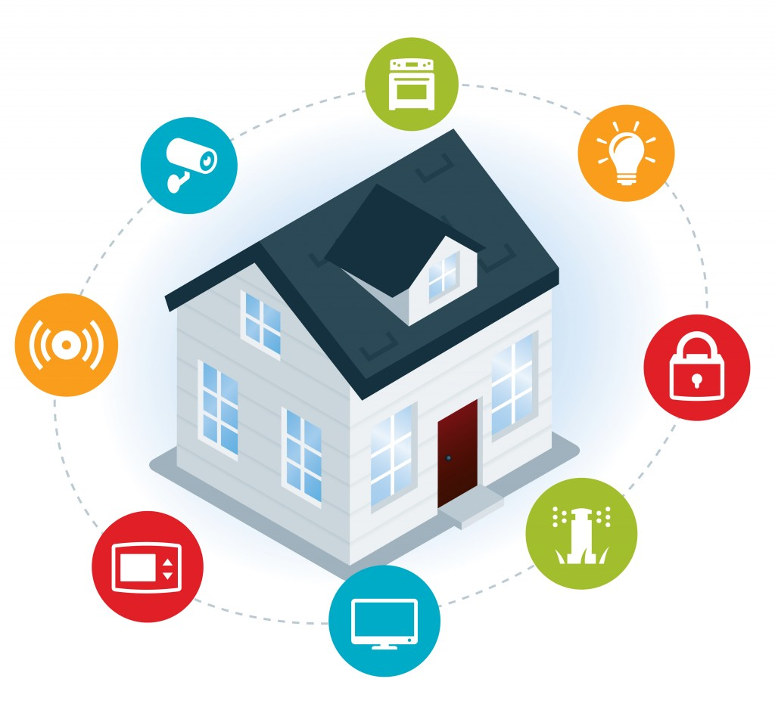
Consumer Guide
1
Challenges encountered by seniors
choosing to age in place
Smart home devices that can help
seniors meet these challenges
Guidance on device selection,
purchase & installation
List of available smart home devices
List of “Senior Specialist Smart Device Installers”
User-tested to ensure comprehensibility & value to seniors

Slide 12
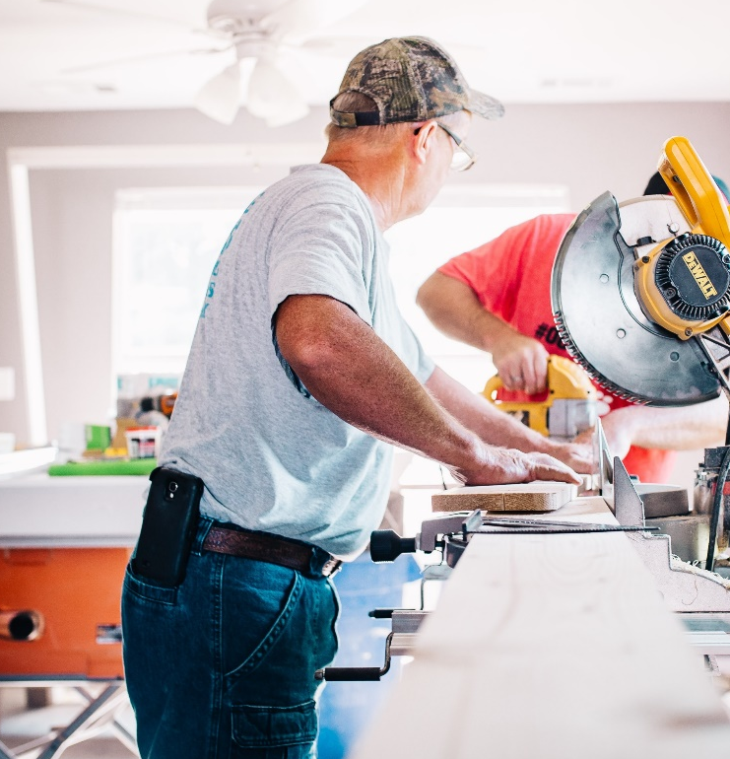


Smart Self Reliance
Information Clearinghouse
2
I-STAR* Online Information Clearinghouse
Interactive version of the Consumer Guide
Searchable database of Smart Technology
A regularly updated blog
A relevant news sections
Tips and guidance for seniors,
family members & care providers
Interactive version of the Consumer Guide
Searchable database of Smart Technology
A regularly updated blog
A relevant news sections
Tips and guidance for seniors,
family members & care providers
Clearinghouse content and site navigation
will be age-optimized following principles of web design for older adults:
  Large clear fonts, graphics, illustrations, color contrasts
  Reduced need for scrolling
  Support for navigations
  User tested with older adults for clarity, ease of use, meaningful labels, navigation, error recovery
Clearinghouse content and site navigation
is age-optimized following principles of web design for older adults:
  Large clear fonts, graphics, illustrations,
  color contrasts
  Reduced need for scrolling
  Support for navigations
  User tested with older adults for clarity, ease of use, meaningful labels, navigation, error recovery
*www.smartselfreliance.org

Slide 13



3. I-STAR Information Clearinghouse
3
Senior Specialist Device Installer Training
Sensitize installers to needs & preferences
of senior homeowners
Customized device installation, programming,
& user instruction
Based on Job Task Analysis with clear
knowledge, skills, and ability (KSA) goals
targeted to desired outcomes
Application of an assessment instrument
to test installer competency
Curriculum focuses on:
  Communication with seniors
  Cognitive, physical, motivational limitations
  Effective device settings to accommodate limitations
  Guidance on effective instructional techniques
  Trouble-shooting & restoring confidence in devices
  Working effectively with care providers

Slide 14
For more information visit: www.smartselfreliance.org
Sample Presentation for Senior Audiences
Collaborating Organization’s Name Here
Extending Knowledge – Changing Lives

